Slide 1
Skinrender
Tom Kedik, Alaric Sheer Hardwick

Slide 2
Current Build

Slide 3
Summary
Outdoor area implemented (including all base assets)
Further animations added
Outdoor puzzles added
Enemy behaviour improved
More indoor assets created

Slide 4
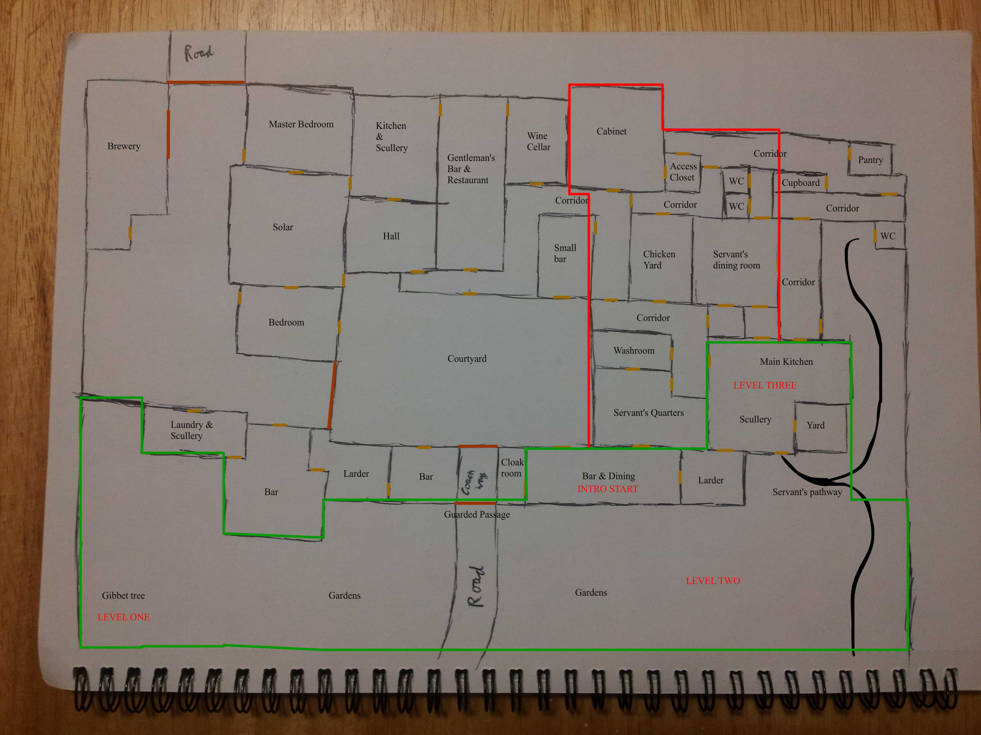
Game World

Slide 5
Milestones
Before Christmas: Core art assets, disguise mechanic, puzzle playtests & iteration. [Complete]
After Christmas: Puzzle designs focusing on recently implemented mechanics, further essential art assets. [Complete]
Before Easter: Core code refined, important animations implemented, audio added, and good amount of game constructed [Almost there!]
After Easter & beyond: Iterating the game’s ‘vertical slice’, implementation of remaining animations

Slide 6
Immediate Future
Walking animations [in progress]
Final world-building props & animations
Iterating intro section
Testing & iterating of outdoor area
Implementing core puzzles (indoor sections)
‘Remaining Asset List’ compiled

Slide 7
Project Management
E-mail communications continuing
Team is aware at all times of task progress due to regular meetings
Hours Logged
Tom Kedik – 162.8h
Alaric – 148.25h
Total – 311.05h

Slide 8
Questions
What would you like to know about Skinrender?

